Slide 1

Games and Big Data: A Scalable Multi-Dimensional Churn Prediction Model
By:
Paul Bertens and team at the Game Data Science Department in Silicon Studios, Japan
Hardik Kapadia
A2, 1911021

Slide 2
Churn Prediction
Churn Prediction is one of the biggest applications od Big Data using Machine Learning
Churn Prediction is a technique used by various global companies to determine the sustainability of their customer base.
Simply put, Churn prediction involves predicting how long a customer is likely to use your service/ products.

Slide 3
The Gaming Industry
In Recent years, the Gaming industry has risen exponentially in value, with an estimated net worth of $115 billion.
One of the many factors for this meteoric rise is the introduction of mainstream mobile games, which account for over the 70% of the gaming industry's net worth.
As the industry becomes larger, new problems emerge...

Slide 4
Churn prediction in the Gaming Industry
As their numbers grow, game development companies need to tackle various new problems which are common among large companies. The problems we are about to see is customer retention.
Along with adding new users, it is also extremely vital for a company to ensure their existing customer base's loyalty.
This is even more important for game development companies because of various factors

Slide 5
Churn Prediction in the Gaming Industry
Churn Prediction is relevant in this industry because:
Unpredictable and dynamic customer base varying across various age groups.
Stagnancy threatens slow growth and change threatens to dwindle their most loyal patrons, hence the need to find the balance between the two.
New financial elements such as paid skins, Loot boxes, etc. present new promotional opportunities as well as threats to overall quality which needs to be tackled.

Slide 6
Why do we need a new approach?
Even though there have been some works on modeling churn in the field of mobile games, they generally use techniques that either make binary predictions, rely on models that are not readily applicable to different data distributions or are not able to capture the temporal dynamics intrinsic to churn.
They also present some drawbacks regarding scalability.
Previous works have shown how to predict the exit of players in terms of days. This study introduces, for the first time in the mobile game sector, a model that accurately predicts the level at which a player is expected to leave the game and their hours of playtime until that moment.

Slide 7

Methodology
The method presented here is an extension of previous work on churn prediction in mobile social games using conditional inference survival ensembles.
Survival Ensemble is an ensemble/ collection of survival trees, which are trees formed using Kaplan Meier estimates to distinguish the different survival characteristics of every sample in the nodes.
Linear rank statistics is used to optimize the data.

Slide 8
Methodology
We then select an optimal split variable based on the relationship between the co-variates and the responses.
We then select an optimal split point using trial and error method.
We then split the trees in suitable subsets and run the model parallelly on various cores on each different subset, each subset utilizing a single core's power.
This not just makes the process efficient, it also makes it more accurate

Slide 9
Dataset
The Paper utilizes a Dataset of player action logs for a mobile Game, Age of Ishtaria, from 2014 to 2017. However, the paper aims to make it as independent of the specific game as possible.
The main data we extracted from this was the player's action logs, daily logins, purchases, playtime, and level-ups.
Not all player's data was selected. The most valuable player's to the company were selected, I.e. the player responsible for a major part of the revenue

Slide 10

Dataset
The Data was cleaned and prepared by removing duplicates, missing value cases. Multiple values were replaced by recent and overall means (e.g. Daily playtime).
The Final dataset is small enough to be scalable enough to accommodate large volumes of players.
It is also robust enough to be generalized for most games

Slide 11
Outcome
The Final outcome is to determine the churning probability of a player.
We decide on two main models to determine this:
The Playtime Model
The Level Model
Each Corresponding to it's name, I.e. Playtime model to predict the number of hours a user will play before quitting and the Level model to predict the Level at which they will quit.

Slide 12
Outcome
For each model, we select the most relevant variables to form the dataset to be fitted into the model for the specific outcome.
Playtime Model: Level, Days since last Purchase, First purchase amount, Last purchase amount, Purchases in the first 9 days, Loyalty index (number of days connected divided by the lifetime), Days since last level up.
Level Model: Lifetime, Days since last Purchase, First purchase amount, Last purchase amount, Purchases in the first 9 days, Loyalty index, Days since last level up.

Slide 13
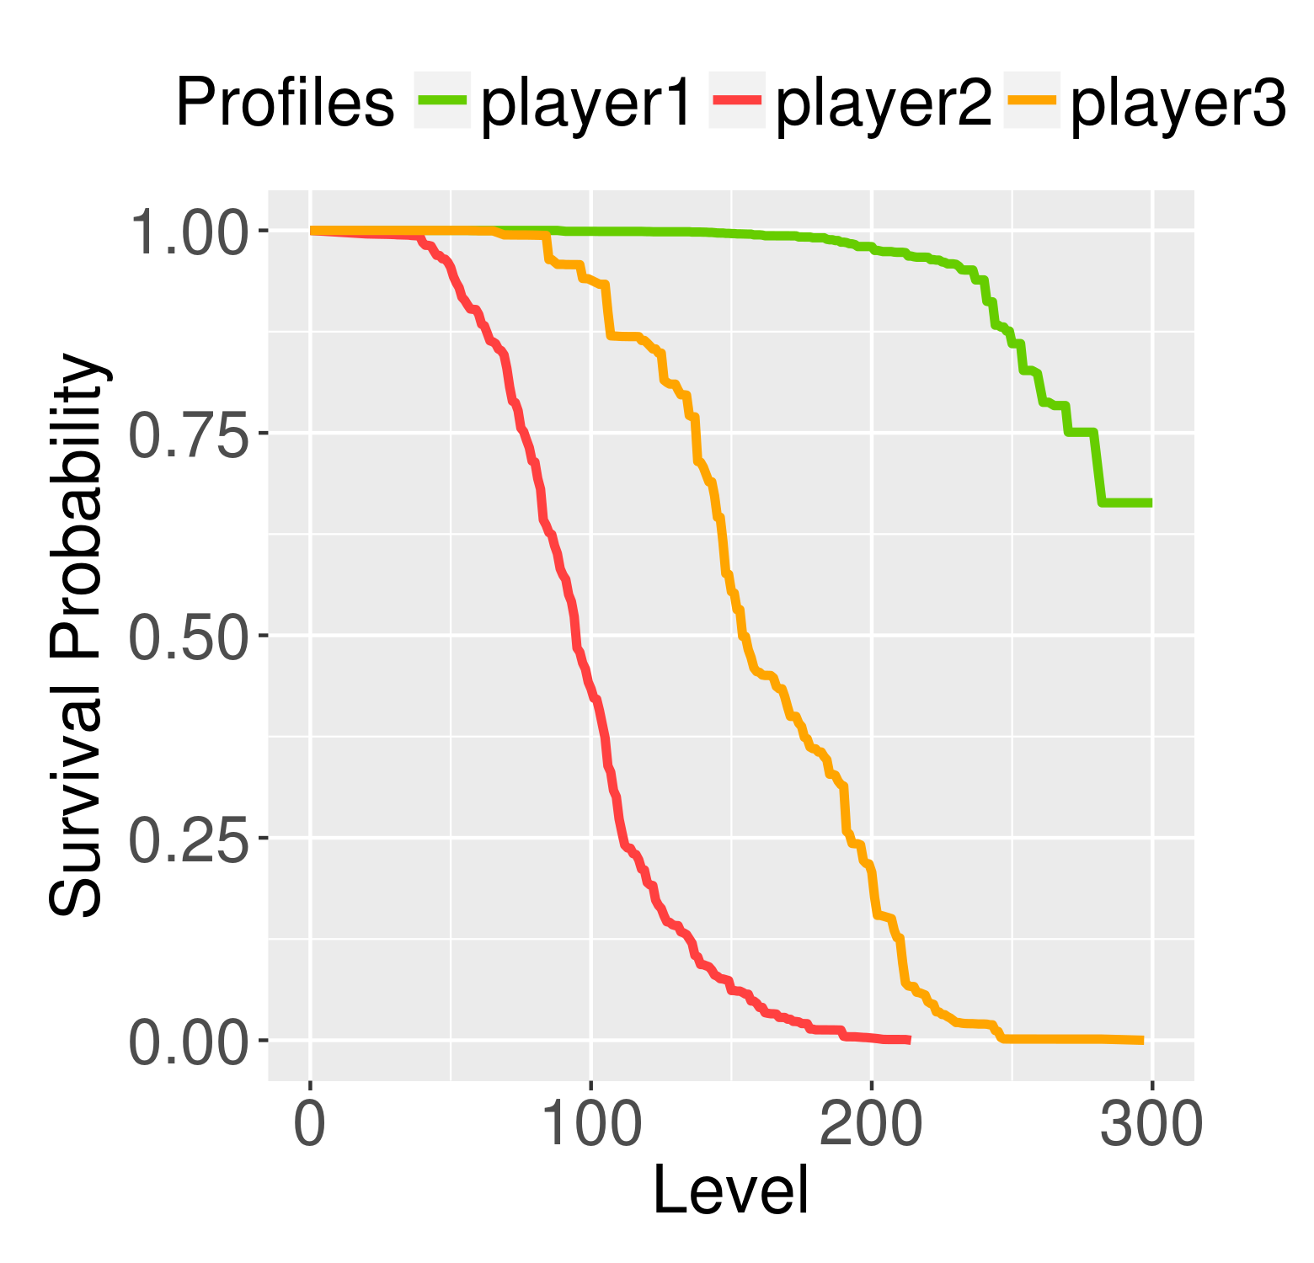
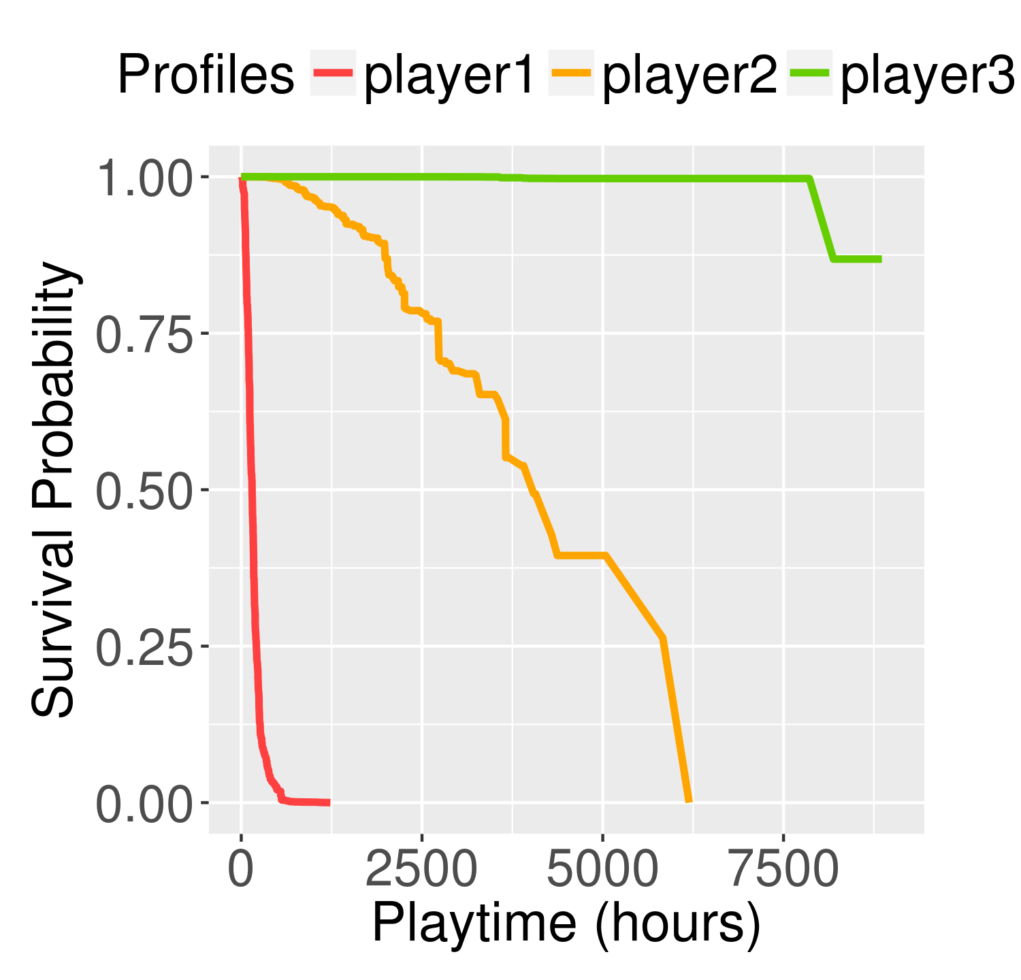
Results
The model described previously outputs a different survival probability curve for every player. We take an example of three players:
Player 1 is expected to churn at an early Level and a lower Playtime
Player 2 is expected to churn at a moderate Level and playtime
Player 3 is expected to survive till a much higher level and large playtime

Slide 14
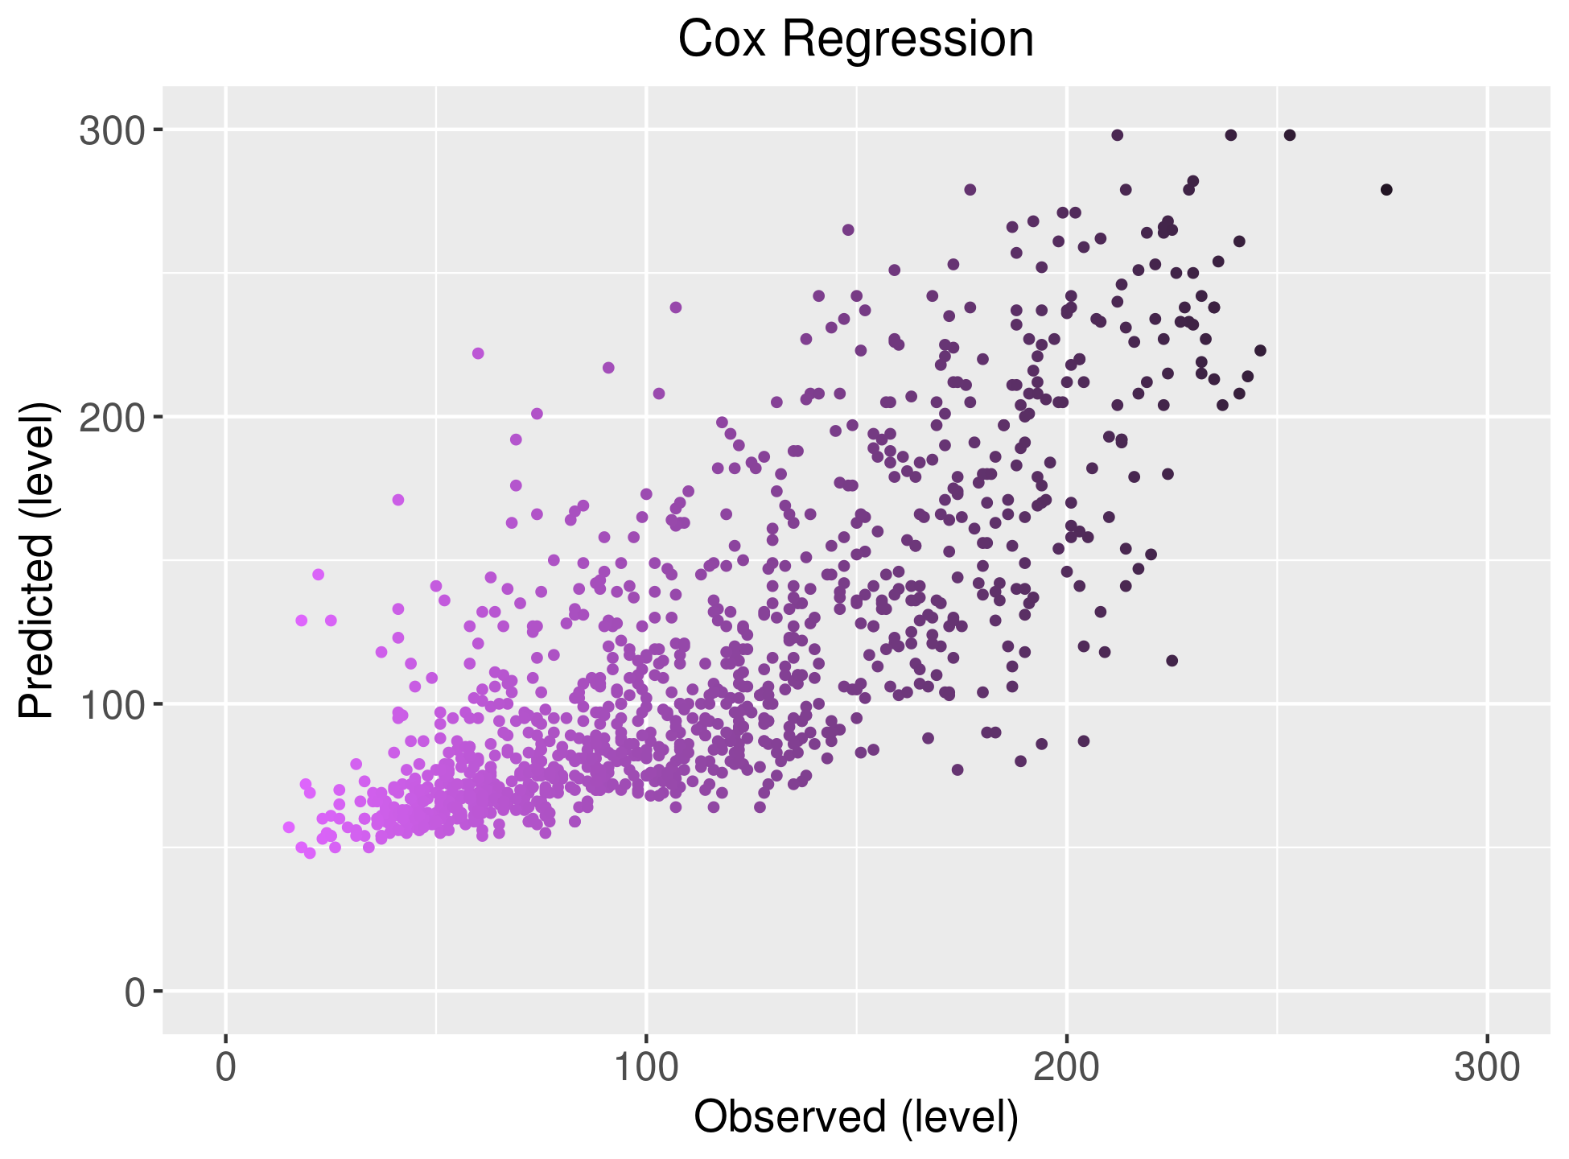
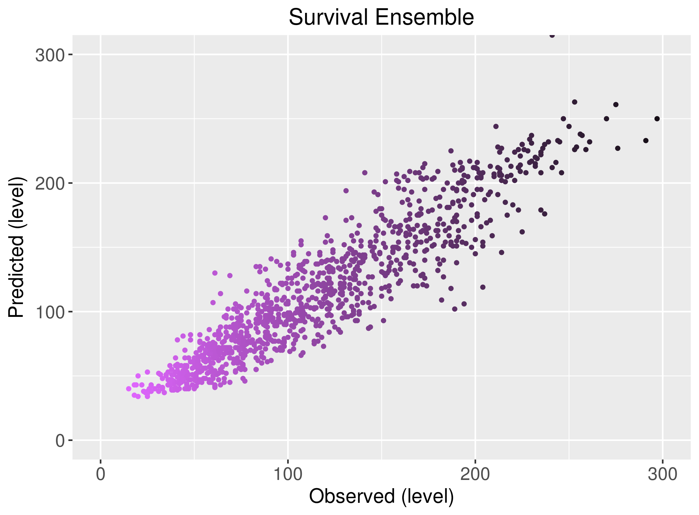
Old vs New

Slide 15
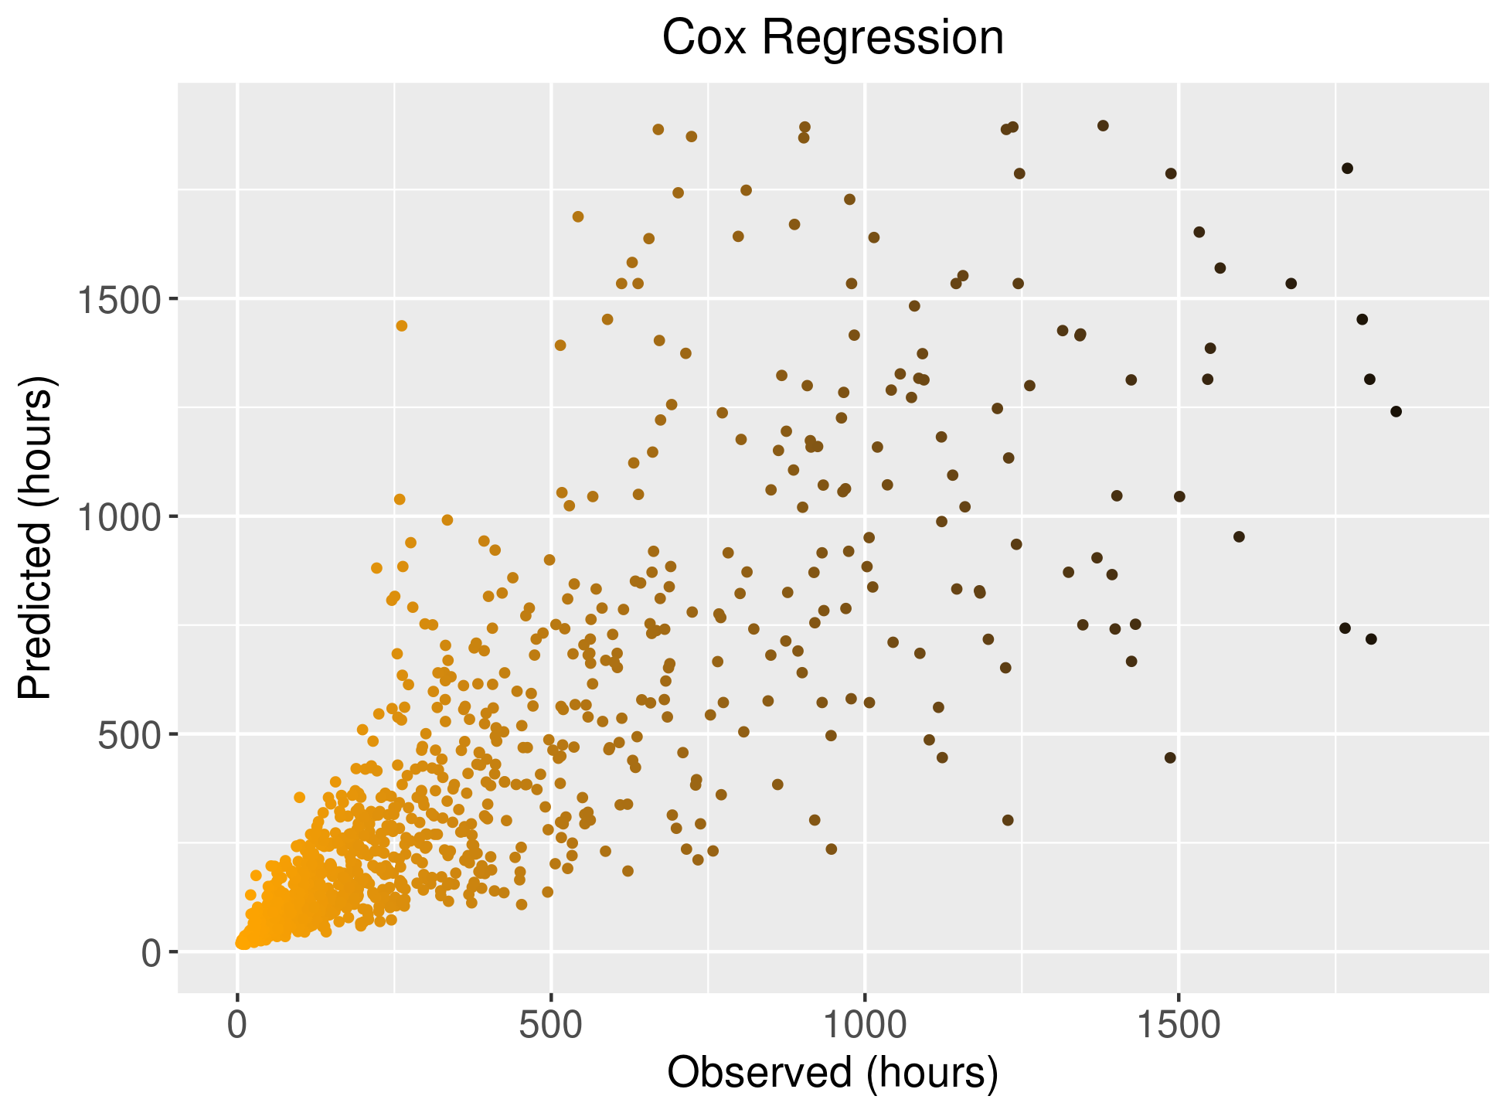

Old vs New

Slide 16
Inference
As we saw from the comparison, The Survival ensemble model is much more accurate especially at higher levels and playtime. The Cox Regression Approach has a much larger spread of points as compared to the Survival Ensemble
This happens due to the lack of data at higher levels and larger playtimes which limits the Cox Regression's ability to successfully predict a player's churn whereas the Survival Ensemble Approach is less susceptible o such vulnerabilities.

Slide 17
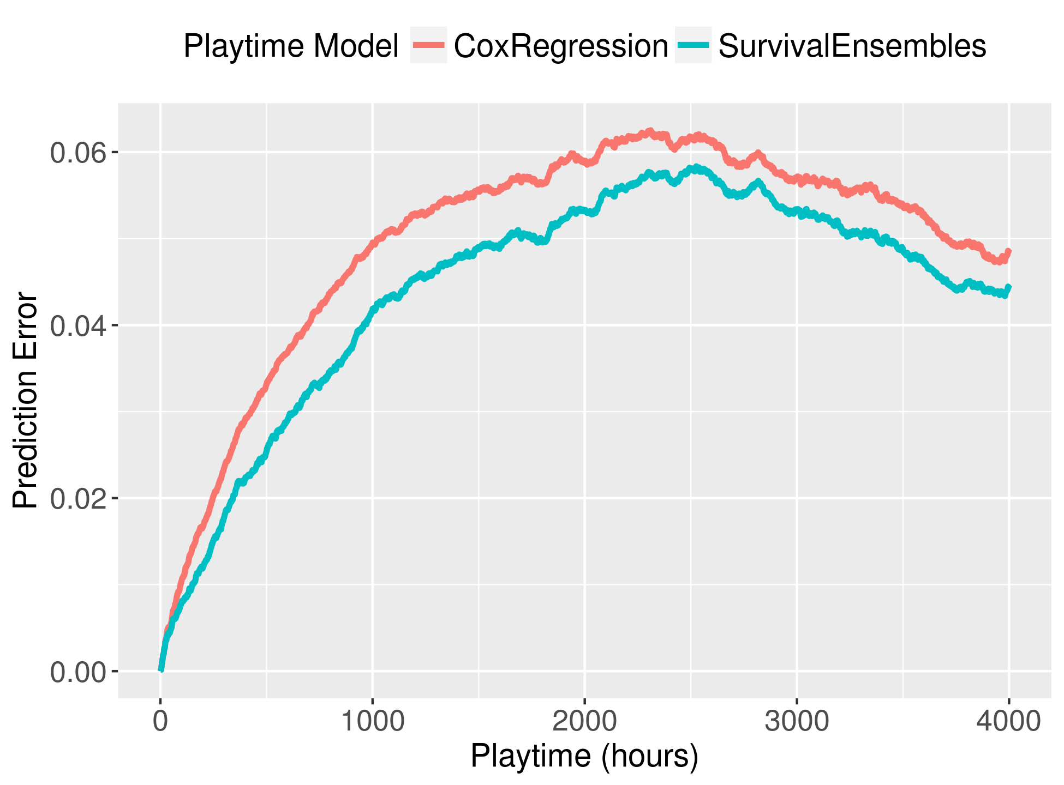
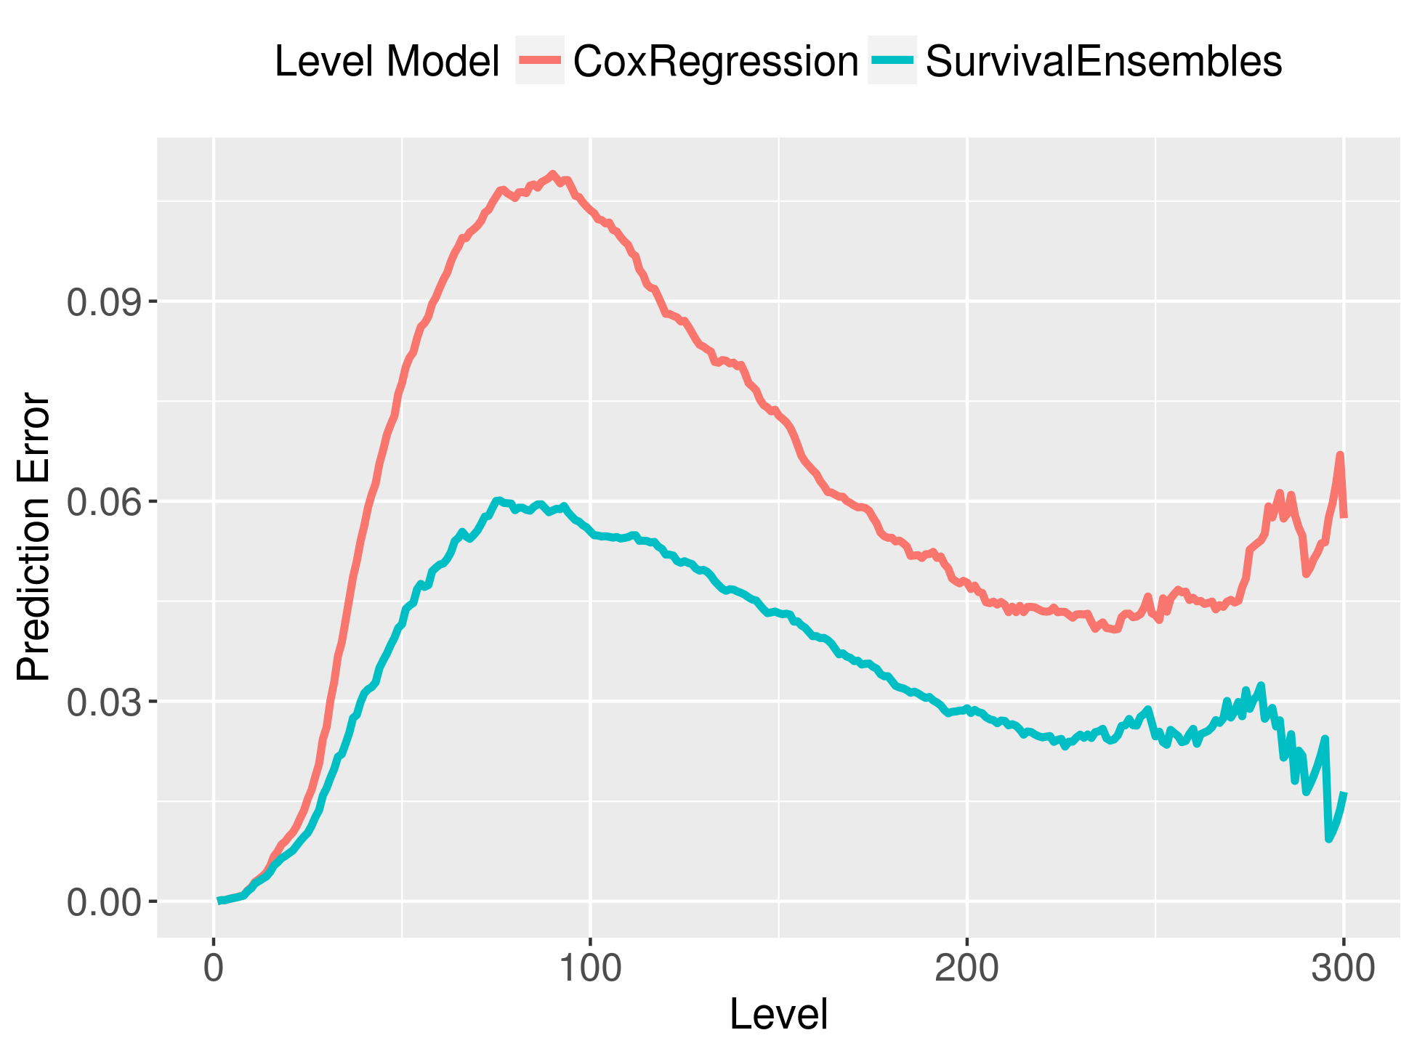
Error

Slide 18
Conclusions
We successfully implemented two machine learning models using survival ensembles and through testing proved it outperformed the Cox Regression models by a large margin in various criteria.
Using the model, we were able to predict the survival rates of a player corresponding to the number of hours played and levels, Hence determining the probability of churning.

Slide 19
References
[1] A. Alfons. cvTools: Cross-validation tools for regression models, 2012. R package, version 0.3.2. https://cran.r-project.org/web/packages/cvTools.
[2] T. G. Clark, M. J. Bradburn, S. B. Love, and D. G. Altman. Survival analysis part I: Basic concepts and first analyses. British Journal of Cancer, 89(2):232–238, 2003.
[3] D. R. Cox. Regression models and life-tables. Journal of the Royal Statistical Society. Series B (Methodological), 34(2):187–220, 1972.
[4] F. Hadiji, R. Sifa, A. Drachen, C. Thurau, K. Kersting, and C. Bauckhage. Predicting player churn in the wild. In 2014 IEEE Conference on Computational Intelligence and Games (CIG), pages 1–8, 2014.
[5] T. Hothorn, K. Hornik, and A. Zeileis. Unbiased recursive partitioning: A conditional inference framework. Journal of Computational and Graphical Statistics, 15(3):651–674, 2006.
[6] U. B. Mogensen, H. Ishwaran, and T. A. Gerds. Evaluating random forests for survival analysis using prediction error curves. Journal of Statistical Software, 50(11):1–23, 2012.
[7] A. Perianez, A. Saas, A. Guitart, and C. Magne. Churn prediction in mobile social games: Towards a complete assessment using survival ensembles. In 2016 IEEE International Conference on Data Science and Advanced Analytics (DSAA), pages 564–573, Oct 2016.
[8] P. Rothenbuehler, J. Runge, F. Garcin, and B. Faltings. Hidden Markov models for churn prediction. In 2015 SAI Intelligent Systems Conference (IntelliSys), pages 723–730. IEEE, 2015.
[9] J. Runge, P. Gao, F. Garcin, and B. Faltings. Churn prediction for highvalue players in casual social games. In 2014 IEEE Conference on Computational Intelligence and Games (CIG), pages 1–8, 2014.

Slide 20

Thank you!

